Slide 1
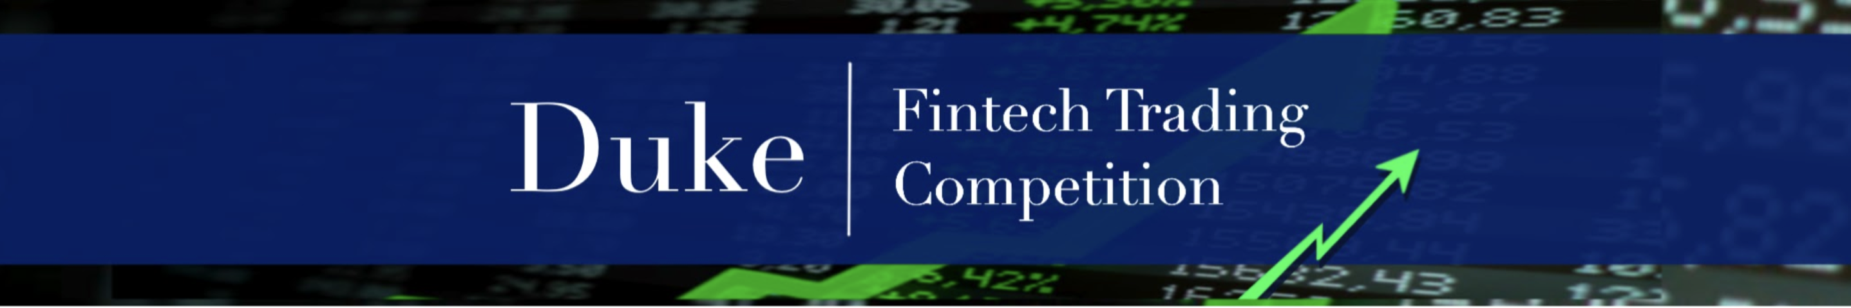
Creating your IBKR Paper Trader

Slide 2
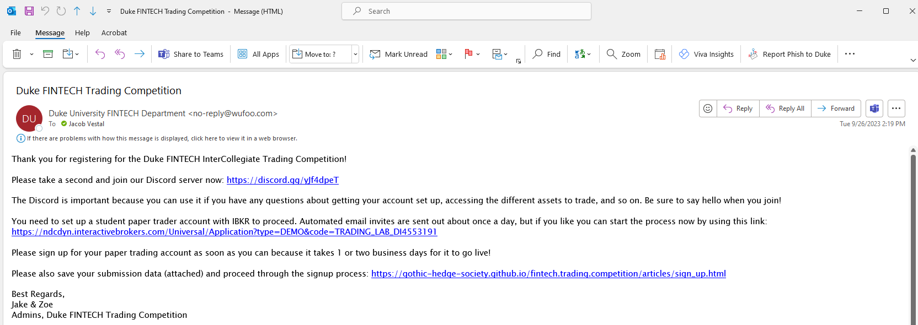
Join the discord
Create your paper trader!
Notes:
After you’ve filled out the signup form on this page, you should receive an email like this one.
Be sure our discord server using the invite link – you’ll use that frequently throughout the competition, and if you run into any problems getting set up, it’s your line of communication to the Competition admins as well as each other!

Slide 3
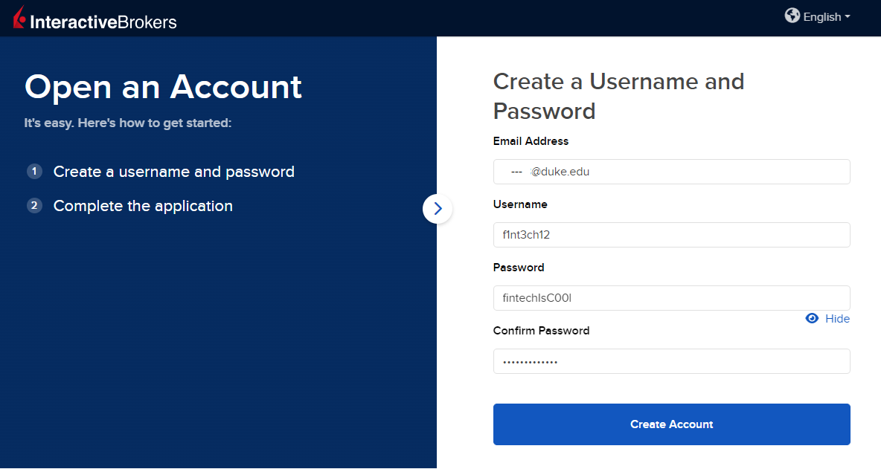
Competition admins don’t have access to the password & username you choose for your paper trader – SO BE SURE TO WRITE IT DOWN SOMEWHERE SAFE!! ☺
Notes:
Create a username & password for yourself. BE SURE TO WRITE IT DOWN because the competition admins don’t have access to this information!
Click “create account” when you’re ready

Slide 4
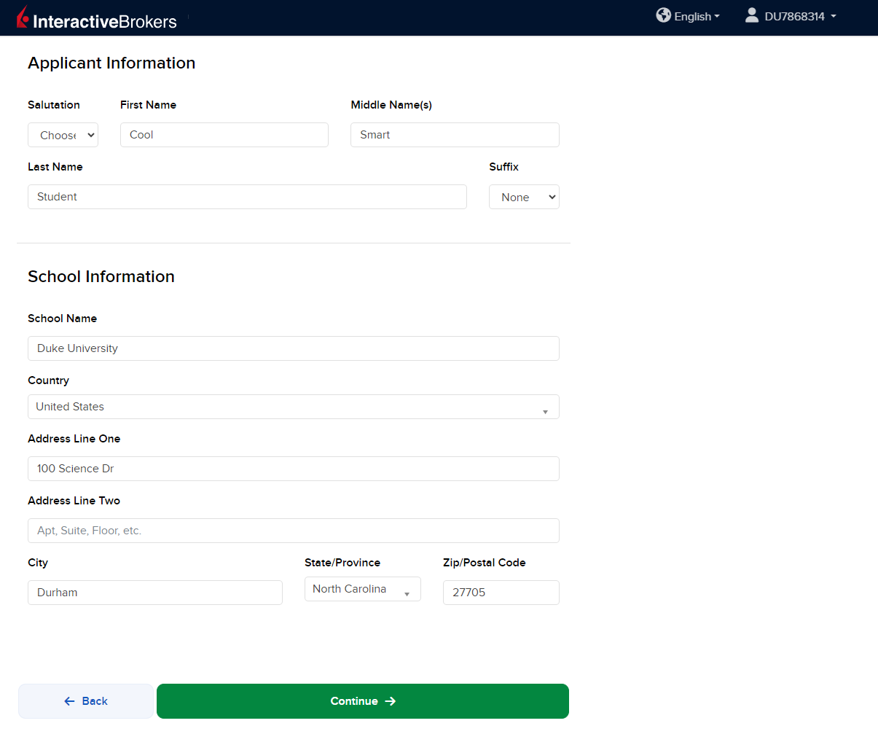
Notes:
Enter your relevant information
Not that your Account Number appears on the upper-right hand corner. Make note of that! Then click continue….

Slide 5
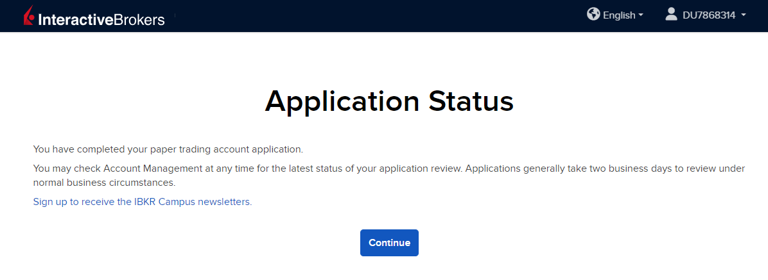
Notes:
When you get to this screen, you’re good to go! Note that it takes about two business days for your account to be fully set up – so be sure to start this process early!

Slide 6
Remember:
Be sure you use the link in your confirmation email to set up your account
This competition is free and for students
You do NOT need to enter any banking or funding info
You do NOT need to answer any more questions than what you saw in this video
→ Post on the Discord with any questions!
Notes:
Don’t forget:
Be sure you use the link in your confirmation email to set up your account
This competition is free and for students
You do NOT need to enter any banking or funding info
You do NOT need to answer any more questions than what you saw in this video
→ Post on the Discord with any questions!

